Slide 1
Database & SQL for Analysis Rockbuster PostgreSQL Database
Jose Hanchi
29 Jun 2023

Slide 2
SUMMARY OF TABLES: film & customer
General description of table fields
from the Rockbuster database

Slide 3
Table: film
1,000 unique records
field name | Minimum | Average/Mode | Maximum
length | 46 | 115.27 | 185
release_year | 2006 | 2006 | 2006
rental_duration | 3 | 4.99 | 7
replacement_cost | 9.99 | 19.98 | 29.99
description | A Action-Packed Character… | n/a | A Unbelievable Yarn of a …
title | Academy Dinosaur | n/a | Zorro Ark
full_text | n/a |  | n/a
rating | G |  | R
special_features | {"Behind the Scenes"} |  | {Trailers,"Deleted Scenes","Behind the Scenes"}

Slide 4
Table: customer
599 unique records
field name | Minimum | Average/Mode | Maximum
Active | 0 [15 records] | n/a | 1 [584 records]
address_id | 5 | n/a | 605
store_id | 1 | n/a | 2
Activebool | n/a | True [all records] | n/a
first_name | Aaron | Jamie | Zachary
last_name | Abney | n/a | Young
email | aaron.selby@sakilacustomer.org | n/a | zachary.hite@sakilacustomer.org

Slide 5
ANALYSIS USING SQL
Determined top countries, top cities, and top paying customers
https://public.tableau.com/app/profile/jose.hanchi/viz/RockbusterDBSQLAnalysis/RockbusterDB

Slide 6
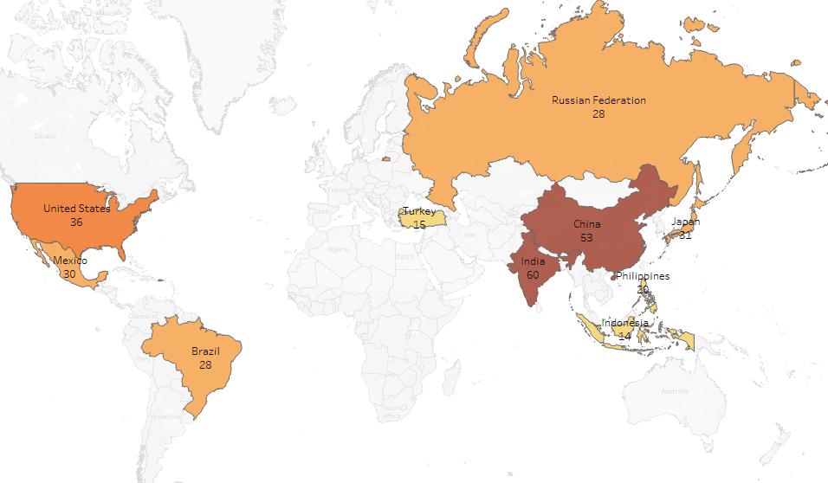
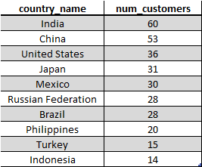
Top 10 countries (number of customers)

Slide 7
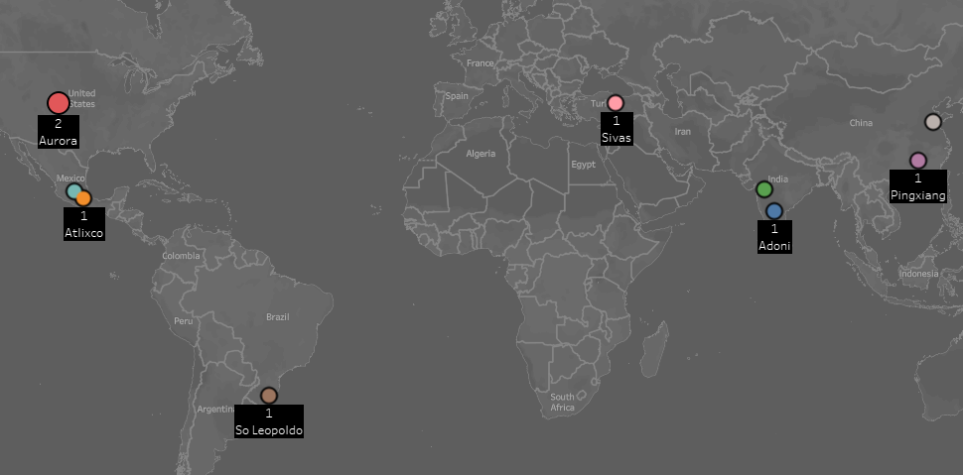
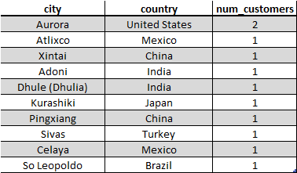
Top 10 cities (from Top 10 countries)
1
Xintai
1
Celaya
1
Dhule (Dhulia)

Slide 8
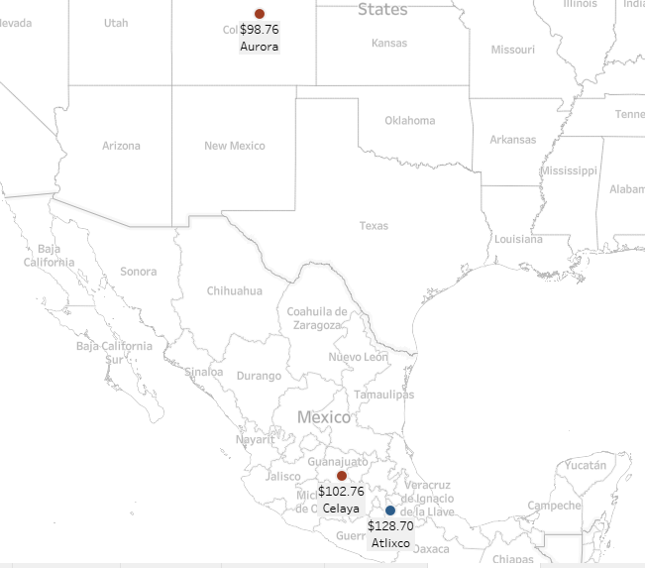
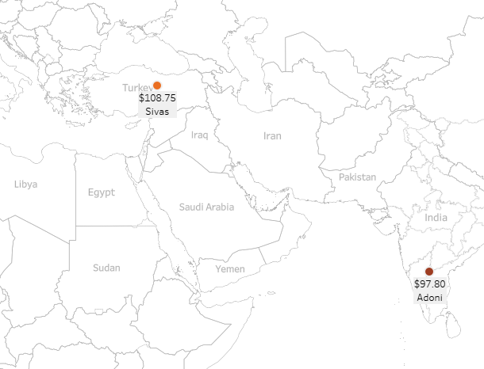
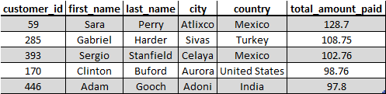
Top 5 paying customers (from Top 10 Cities)
Americas
Europe / Asia

Slide 9
appendix

Slide 10
fact table
film actor
actor
dimension table
inventory
film
language
rental
film category
category
payment
customer
staff
address
city
country
store

